Slide 1
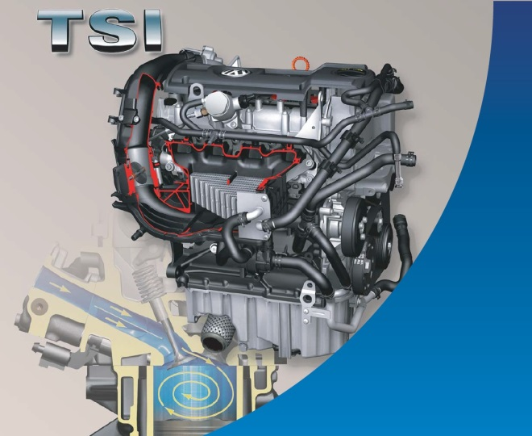
ZENIT PRO DIRECT AND DIRECT INJECTION TECHNOLOGY

Slide 2
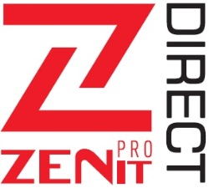
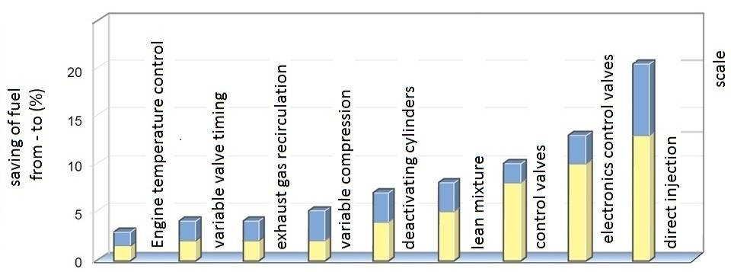
Direct injection technology
- target
The main objective pursued by the development of engine design, the maximum reduction of harmful emissions, including CO2

Slide 3
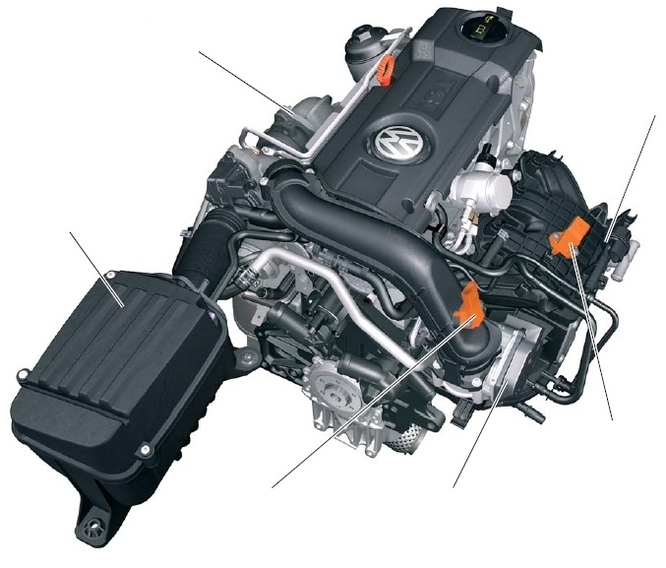
Direct injection technology
- Engine
Turbocharger
Intake manifold
Air filter
Map sensor with
temperature sensor
Boost pressure sensor
Throttle

Slide 4
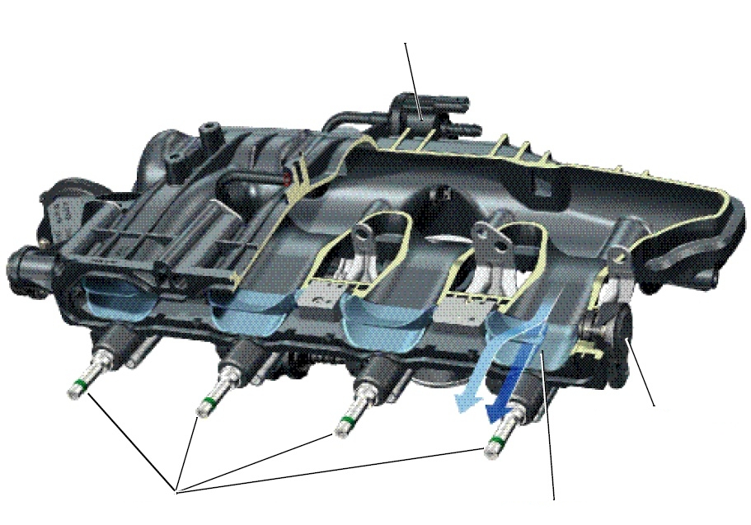
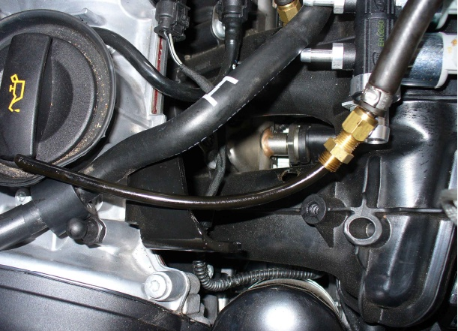
Direct injection technology
- Intake system
solenoid valve flap control position
flap position sensor
petrol injectors
flap control air flow

Slide 5
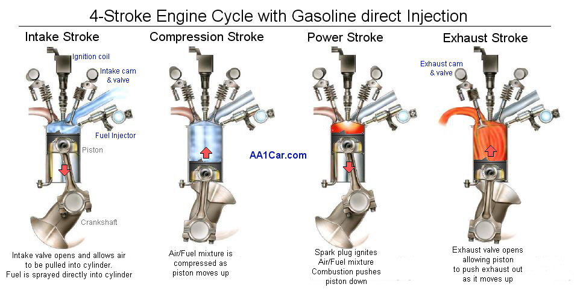
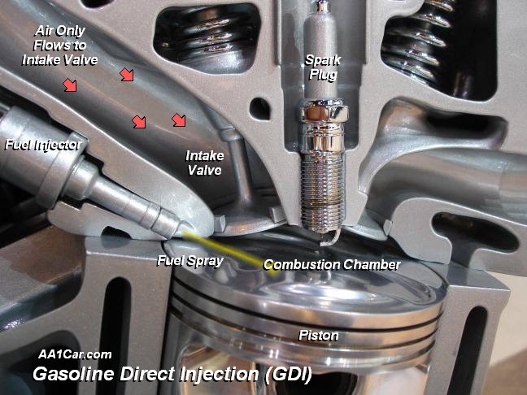
Direct injection technology
- Fuel system

Slide 6
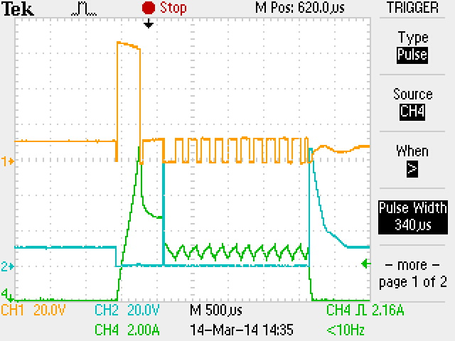
Direct injection technology
- petrol injectors control
Injectors used in direct injection systems are approximately 3 times faster than those in traditional systems.
Opening time on idle - ok. 1ms
Maximum opening time - ok. 7 ms
Injection faze | Voltage | Current | Duration
A: High Peak | 60V | 12A max. | 0,2-0,4 ms
B: Peak | 12V | ok. 5A | ok. 0,5 ms
C: Hold | 12V - PWM | ok. 3A | 0 – 7 ms
A
B
C

Slide 7
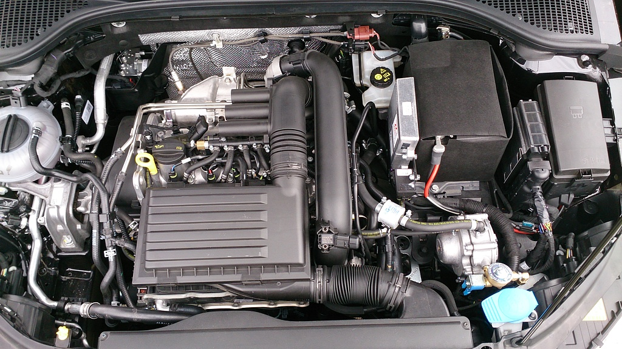
Gas supply system
- assembling
Components of the system :
electronic control unit and switch, sensors, wiring harness, Injetors HANA
Vaporizer KME Silver/ Gold, Gurtner Silver , Gurtner Black
Filter
the bag assembly (similar as per conventional systems)

Slide 8
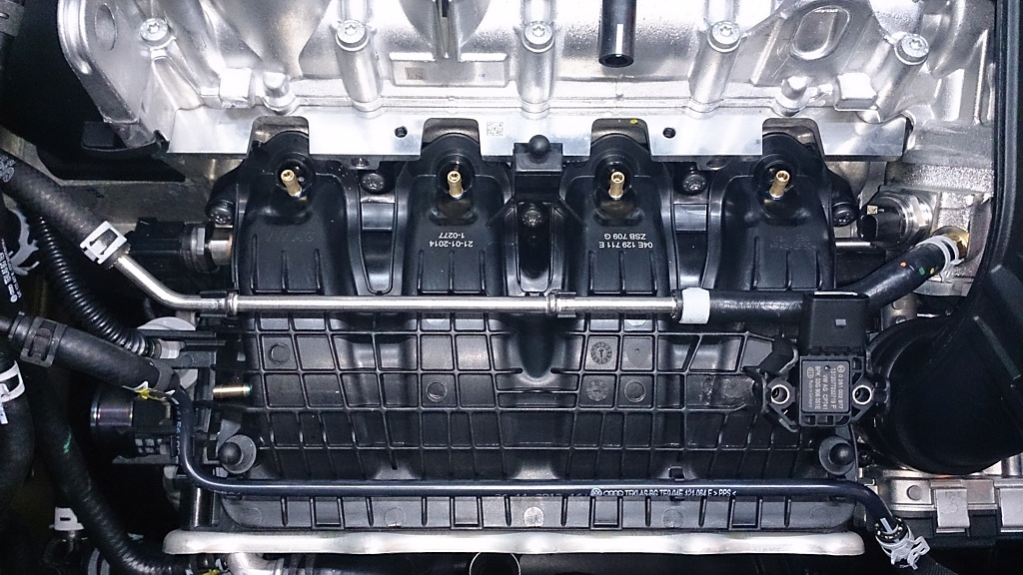
Gas supply system
- nozzles in the manifold
Installation of nozzles in the intake manifold engine with direct injection gasoline requires more attention than the standard engine.

Slide 9
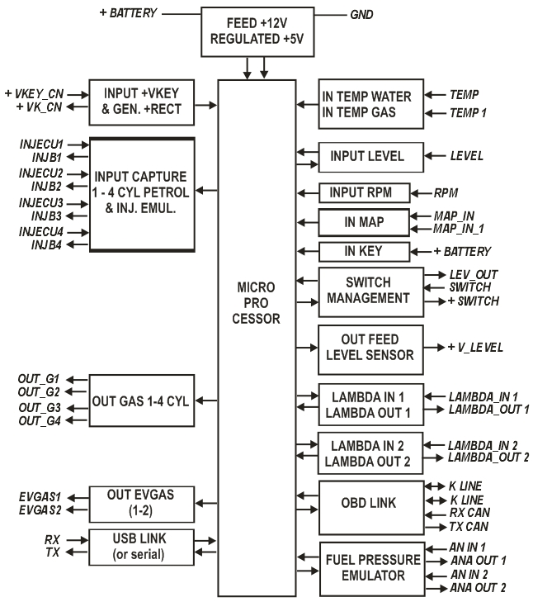
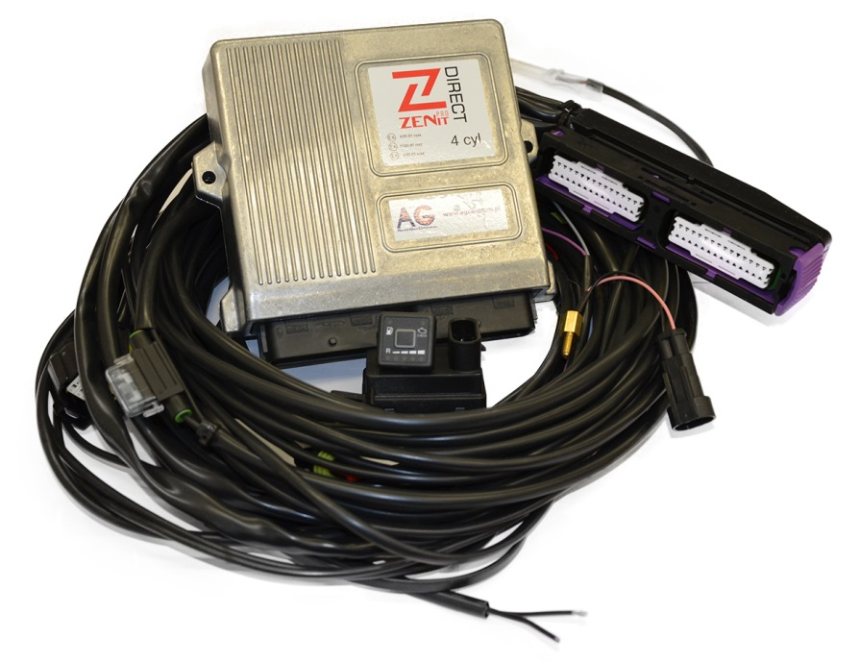
Gas supply system
- ECU

Slide 10
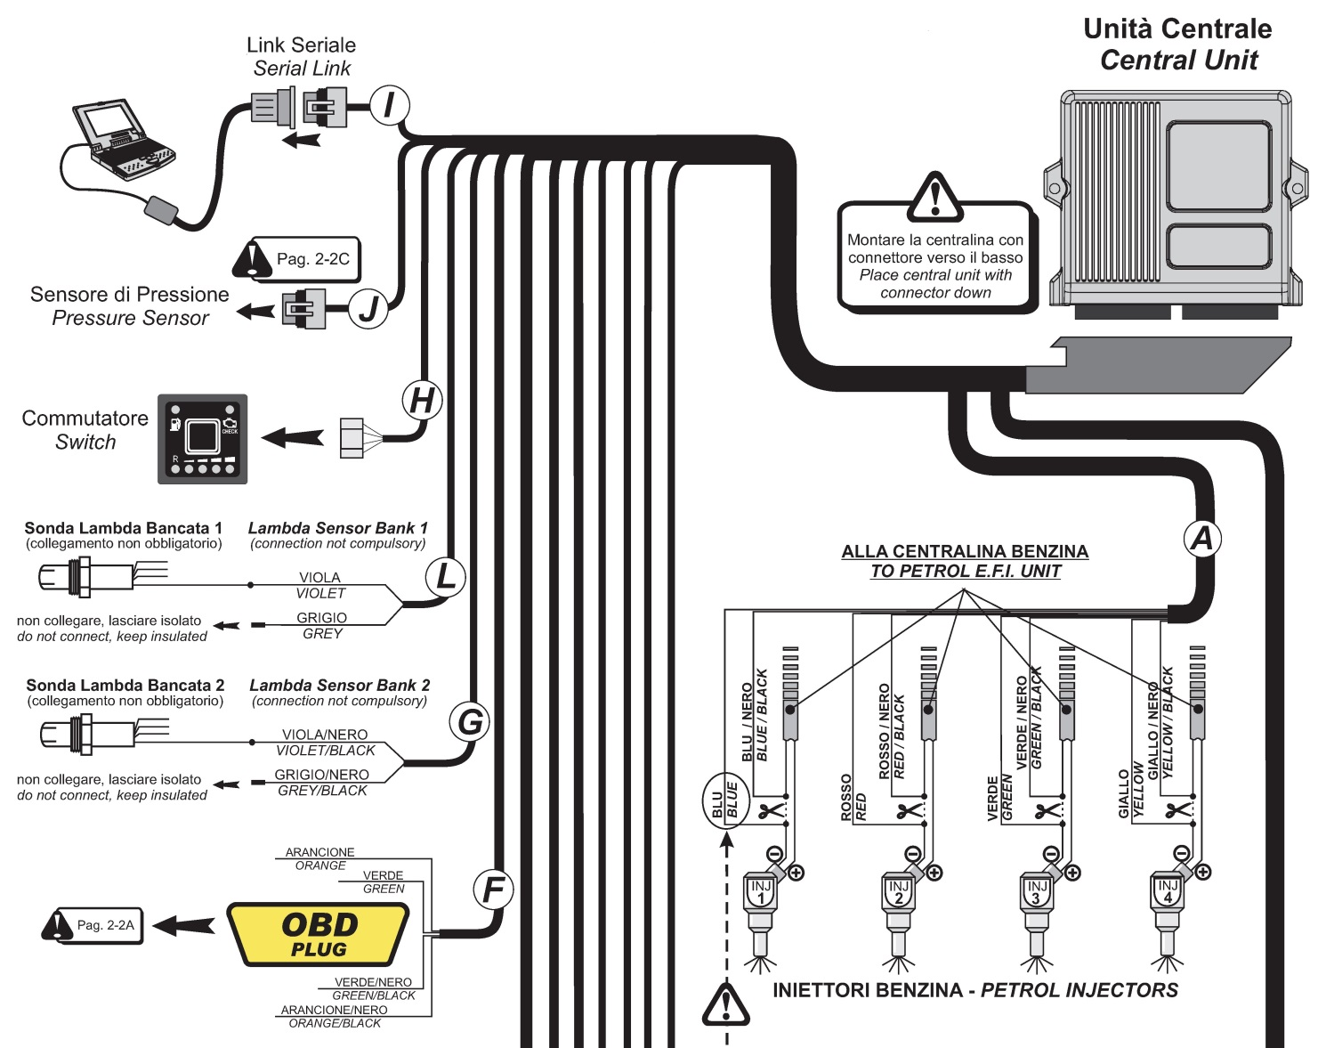
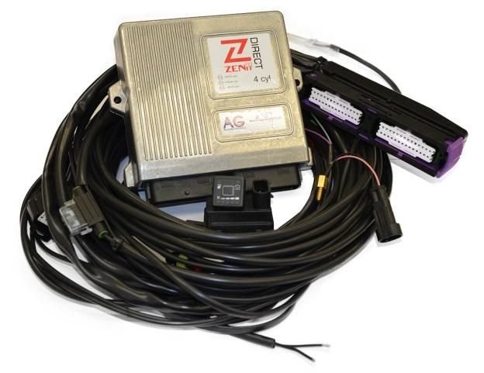
Gas supply scheme
- wiring diagram

Slide 11
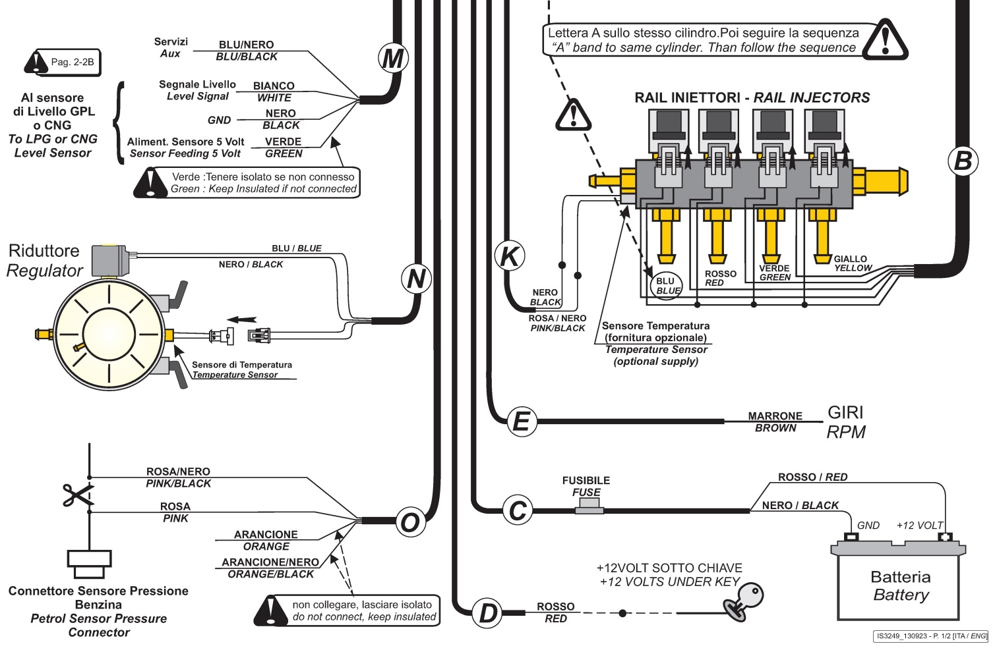
Gas supply scheme
- wiring diagram

Slide 12
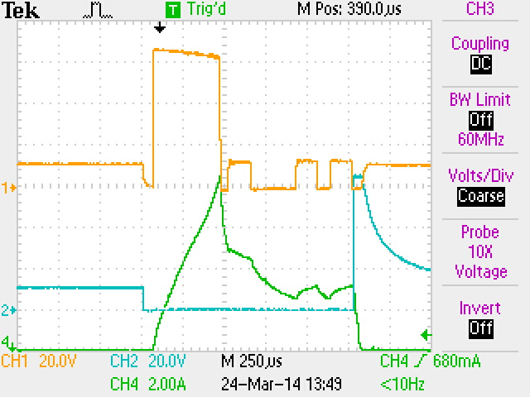
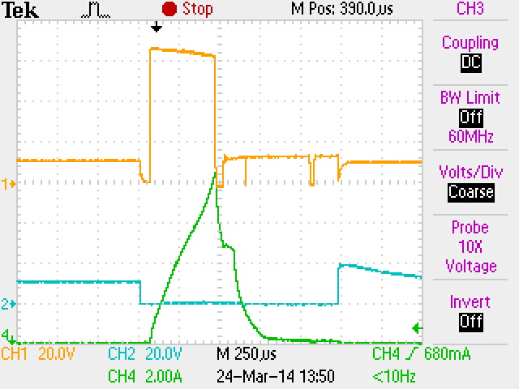
Gas supply scheme
- petrol injectors control
t1
t1 –petrol injector opening time idling while running on petrol
t2 + t3 - petrol injector opening time idling while working on the gas, where :
t2 – dose of petrol
t3 – time in which the emulator is enabled and petrol injector is closed
t2
t3

Slide 13
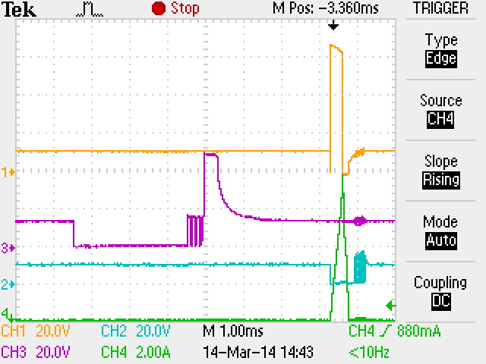
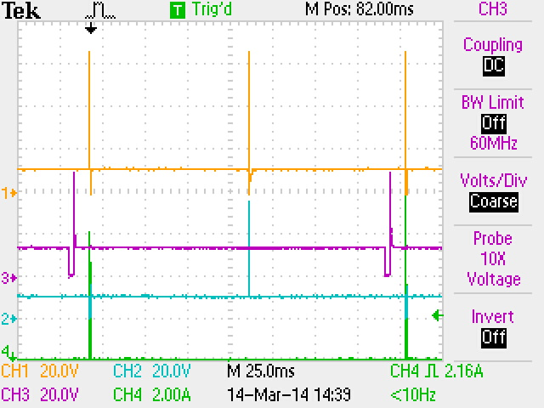
Gas supply scheme
- gas injection control
Gas injection is usually accelerated with respect to petrol injection
The Zenit PRO DIRECT allows continuous adjustment of injection timing depending on engine RPM and load

Slide 14
Gas supply scheme
- software
Two versions of the software:
1. Engineering version 2. Installers version

Slide 15
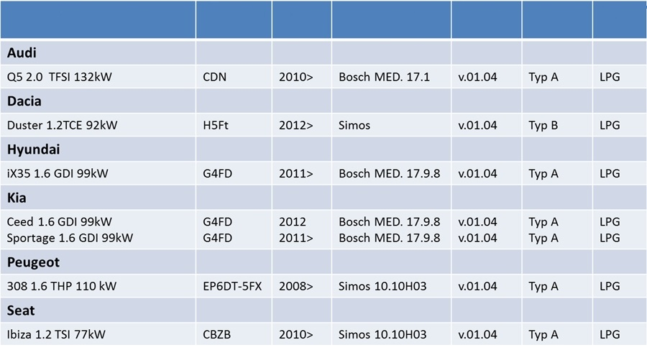
Gas supply scheme
- use of, apps
TYPE AND MODEL
ENGINE CODE
YEAR OF
PRODUCT.
ECU PETROL
FIRMWARE
HARDWARE
FUEL

Slide 16
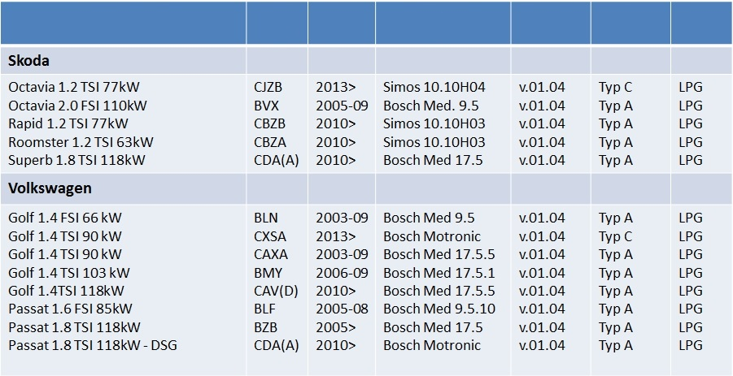
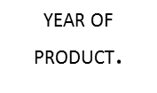
Gas supply scheme
- use off, apps

Slide 17
Gas supply scheme
- use off, apps
Along with purchasing the installation customer receives:
front-kit contains basic components such as: electronic control unit and switch, sensors, vaporizer, injectors, filter, the bag assembly (similar as per conventional systems);
ECU configuration file dedicated to a specific engine model;
manuals dedicated to a specific engine model ( kit assembling, the source of electrical signals, installation of nozzles in the manifold).

Slide 18
Comparison of traditional
and a system for direct injection
 | Zenit PRO DIRECT | Zenit PRO / PRO OBD
Application | Engine 4 cyl., LPG, VAG TFSI/TSI, GDI | Engine 3 – 8 cyl., LPG – CNG, with multipoint injection system
Gasoline consumption | 10 – 15% | 2 – 5 %
Petrol pressure | 20 – 200 bar | 4 – 6 bar
Resistance petrol injectors | 1,9 – 2,5 Ω | 10 – 15 Ω
Petrol injection time | 0 – 7 ms (10 ms after chiptuning) | 0 – 25 ms
Petrol injection time on idle | 1 ms | 3 ms
Additional electrical connections | Fuel pressure sensor, OBD | OBD
Configuration of gas | Dedicated | Universal
Compensations | Reducer temperature compensation Gas temperature compensation Supply voltage compensation Gas pressure compensation Petrol pressure compensation OBD system | Reducer temperature compensation Gas temperature compensation Supply voltage compensation Gas pressure compensation Acceleration compensation OBD and Adaptive Map

Slide 19
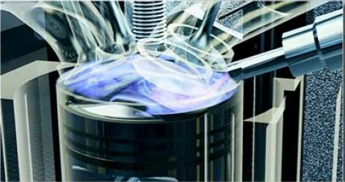
Thank you for your attention

